Slide 1
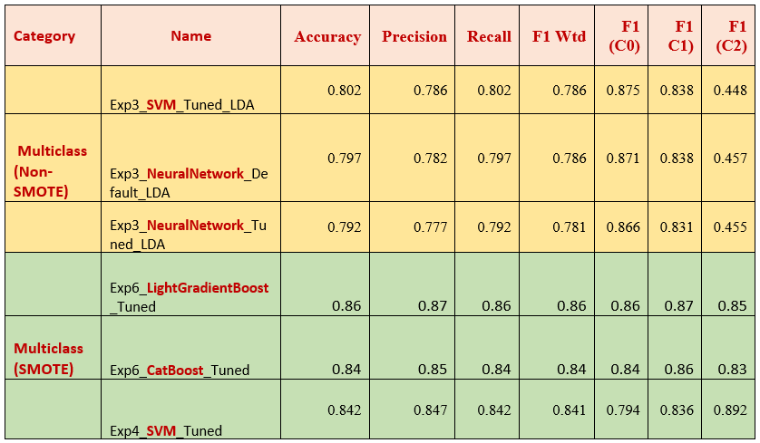
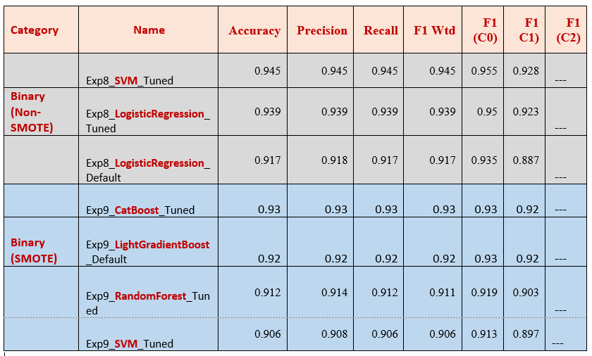
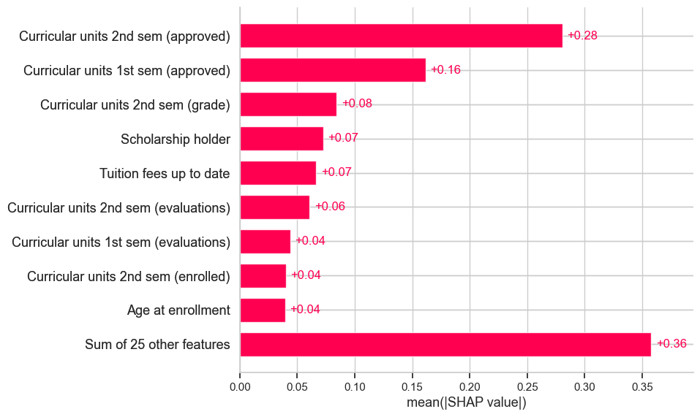
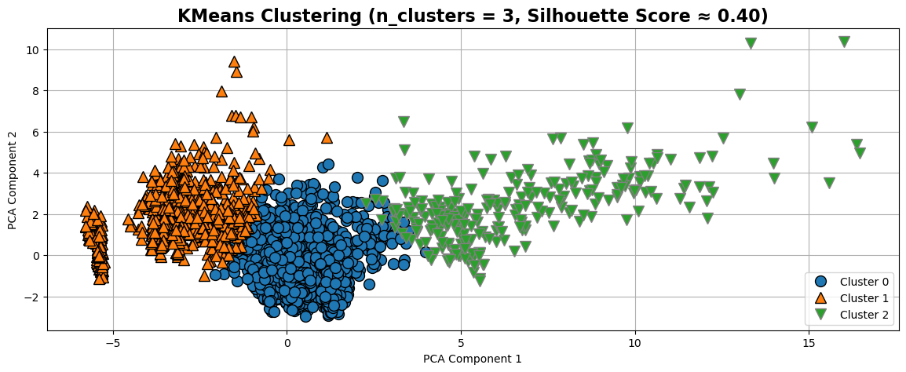
A Holistic Machine Learning Pipeline for Academic
Outcome Prediction
Selvi Ganesh Kumar
CCT College, Dublin, Ireland
Abstract
Multiclass classification – Top results
This study explores machine learning models for predicting student dropout and academic success using a real-world higher education dataset. Eleven experiments tested diverse preprocessing strategies, including PCA, LDA, and outlier detection via Isolation Forest. Class imbalance was addressed using SMOTE, ADASYN, and NearMiss—SMOTE proved most effective. Six traditional algorithms and four boosting models (LightGBM, CatBoost, XGBoost, Gradient Boosting) were tested under default and optimized settings. SVM, LightGBM and CatBoost performed best in multiclass prediction on SMOTE datasets. Clustering via KMeans and KMedoids (post t-SNE/Autoencoders) revealed moderate separation (silhouette ≈ 0.41). A binary classification (Graduate vs Dropout) showed traditional models slightly outperforming boosting models on non-SMOTE data.
Best Models
Objective
Developing early warning systems based on predictive analytics can significantly aid in detecting students at risk of dropping out and in delivering targeted support.
Research questions:
RQ1: Which machine learning algorithms are most effective in predicting student dropout?
RQ2: How effective are different resampling techniques (SMOTE, ADASYN, NearMiss) in addressing class imbalance for dropout prediction?
RQ3: How do boosting algorithms (Gradient Boosting, XGBoost, CatBoost, LightGBM) compare to traditional ML models in predicting dropout?
RQ4: What key factors contribute to student success or failure, as identified by SHAP, LIME, and RF Feature Importance?
RQ5: Can unsupervised ML techniques like clustering effectively reveal patterns or groupings within the dataset?
Binary Classification – Top results
Predictors - SHAP
Clustering Analysis
Conclusions
SVM (tuned) proved to be the most efficient model across both multiclass and binary tasks. Boosting models like CatBoost and LightGBM also performed strongly with SMOTE.
ROC and Precision-Recall curves consistently showed AUC and Average Precision scores above 0.90. SMOTE significantly improved F1 scores for minority classes.
SHAP, LIME, RF Feature importances and Clustering revealed patterns tied to academic, financial features and Course as key predictors.

